Slide 1

Ridge regression

Slide 2
Why Ridge regression
Reduce overfitting by using shrinkage methods
Offers feature shrinkage.

Slide 3
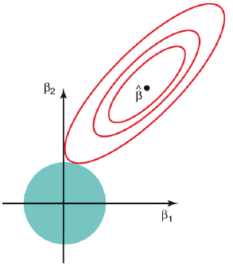
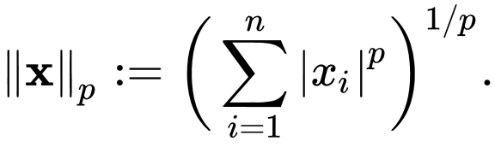
Norms
The L2 norm or also known Euclidean length
It can never be zero.

Slide 4
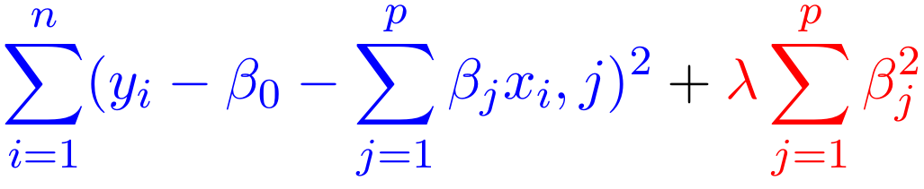
The formula
Blue we have the residual sum of square (RSS) term
Red we have the regularize or penalty term.
When the penalty term is 0 it is normal RSS
When the penalty term is large it shrinks data.

Slide 5
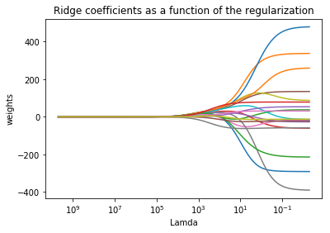
Using it on the hitters data set
The higher lambda the more the Regularization term
Will never reach zero but will be close, floating point math can be hard for the pc

Slide 6

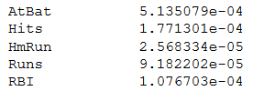
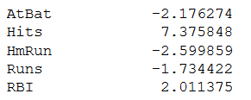
Choosing the best Lambda is important
Lambda = 4
Lambda = 10^10
Lambda found using cross validation: 2.36

Slide 7

Questions

